Slide 1


Noise Reduction in Communication Signals Using Deep Neural Networks
DIGITAL SIGNAL PROCESSING
MACHINE LEARNING
Exploring Deep Learning techniques to enhance signal quality by removing Gaussian noise from composite sinusoidal signals.
AAKASH GANGOTRI 1032240115
ABEER CHOUDAHA 1032233636

Slide 2

The Challenge
Real-World Signal Corruption
Transmitted signals face inevitable corruption from thermal sources, interference, and channel degradation. Recovering the original clean signal is critical for data integrity.
Traditional filters are computationally cheap but struggle to preserve high-frequency details or adapt to complex noise patterns.

Slide 3
Project Objectives
01
02
Generate Synthetic Signal
Simulate Noisy Channel
Create composite signal representing communication waveform
Introduce Gaussian White Noise to test conditions
03
04
Implement DNN
Benchmark Performance
Train sequential Deep Neural Network for noise suppression
Compare DNN results with Moving Average filter

Slide 4
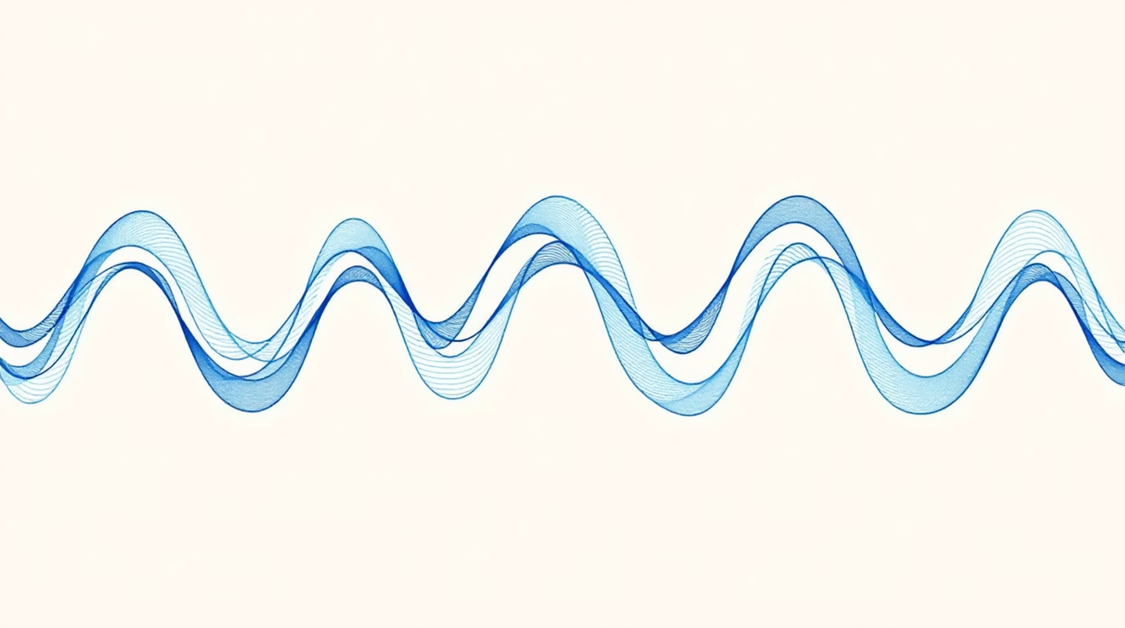
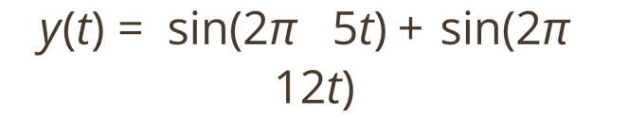
Signal Generation & Noise Addition
Clean Signal Composition
Synthetic signal composed of two distinct frequencies (5 Hz and 12 Hz) simulating complex waveform:
Gaussian noise added with standard deviation σ:

Slide 5


Two Approaches Compared
Moving Average Filter
Deep Neural Network
Traditional Method
Proposed Method
Window size: 5. Averages signal points within sliding window to smooth fluctuations. Fast and simple but degrades high-frequency components.
Feed-forward DNN learns regression map predicting clean amplitude from noisy input. Leverages non-linear ReLU activation for complex pattern recognition.

Slide 6

DNN Model Architecture
Input Layer
Hidden Layer 1
Hidden Layer 2
Output Layer
Receives noisy signal amplitude
64 neurons, ReLU activation
64 neurons, ReLU activation
1 neuron, linear activation
Training Configuration: Adam optimizer, MSE loss function, 100 epochs

Slide 7

Performance Metrics
Mean Squared Error (MSE)
Measures average squared difference between estimated and actual values. Lower is better.
Signal-to-Noise Ratio (SNR)
Ratio of signal power to noise power, expressed in decibels (dB). Higher is better.

Slide 8
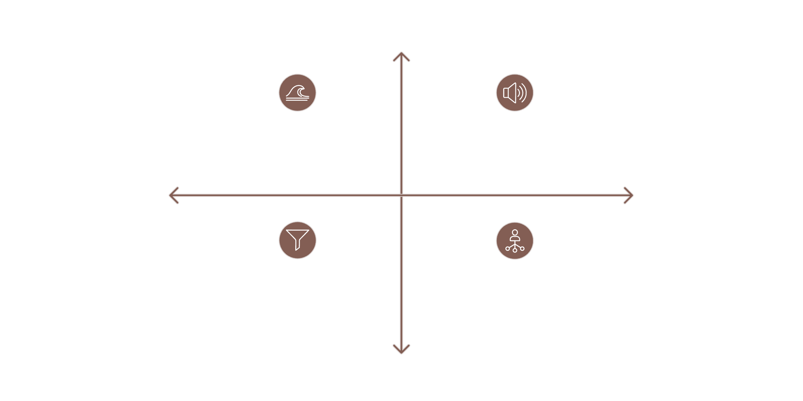




Experimental Results
High Fidelity
Clean Signal — Ideal Dual-Frequency Wave
Noisy Signal — Gaussian Distorted Wave
Low Noise
High Noise
Moving Average — Smoothed with Phase Lag
DNN Denoised — Reconstructed, Peaks Preserved
Low Fidelity
The DNN successfully reconstructed the wave shape, preserving peaks better than the moving average while the MA filter exhibited phase lag and attenuation of high-frequency components.

Slide 9
Quantitative Performance Comparison
Metric
Input (Noisy)
Moving Average
DNN
Key Finding
Training loss curve demonstrated effective MSE minimization over 100 epochs, indicating successful convergence without significant overfitting.
SNR (dB)
Low
Moderate
High
MSE
N/A
Moderate
Low
The DNN approach showed higher output SNR and lower MSE, indicating successful learning to distinguish signal patterns from stochastic noise.

Slide 10
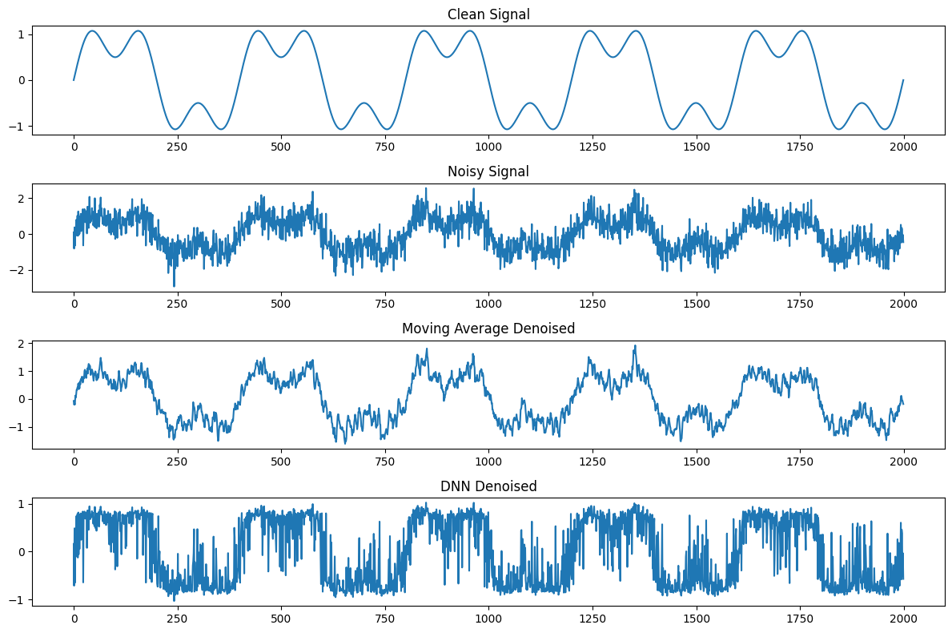

Slide 11

Conclusion & Future Scope
Project Success
Future Directions
Deep Neural Networks successfully demonstrated superior signal denoising compared to traditional Moving Average filters. The DNN learned to distinguish underlying signal patterns from noise, providing robust reconstruction.
Implement RNN/LSTM for time-series advantages
Optimize for real-time embedded device deployment
Extend to audio and voice signal denoising

